Slide 1



TW-11
C/Cavazos and C/Campbell
Air Force ROTC Detachment 842
The University of Texas at San Antonio

Slide 2


Overview
Plan
GMC Instructions
Designated Form Up Location
Form Up Map
Location Photos
Air Force ROTC Detachment 842 • We Build Exceptional Officers • The University of Texas at San Antonio

Slide 3
Plan
Time: | Squadron 1 | Squadron 2
1600-1640 | Rotation 1: 40 minutes | Flight Time (At form up location)
1640-1645 | Transition | Transition
1645-1725 | Flight Time (At form up location) | Rotation 2: 40 minutes
1725-1735 | Transit to Wing Breakout | Transit to Wing Breakout
Air Force ROTC Detachment 842 • We Build Exceptional Officers • The University of Texas at San Antonio

Slide 4

GMC Instructions
Be formed up NLT 1545.
Be aware that all GMC will be required to get signatures of the POC stationed at the tables, you will need at least 3 signatures from different tables.
Do NOT stay at one table the entire time.
The squadron that is waiting will have flight time, this will be up to the flight commanders discretion.
Once finished, Squadron 1 will transition outside.
Squadron 2 will then enter.
Air Force ROTC Detachment 842 • We Build Exceptional Officers • The University of Texas at San Antonio

Slide 5
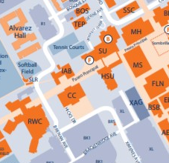
Designated Form up
GMC form up location will be outside the Student Union.
Air Force ROTC Detachment 842 • We Build Exceptional Officers • The University of Texas at San Antonio

Slide 6
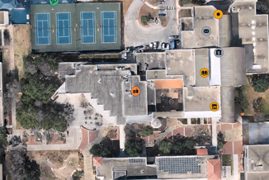
Form Up Map
Student Union Address Link:
https://maps.app.goo.gl/Ji8g6rRZyRrsLPT2A
H-E-B University Center, 1 UTSA Circle, San Antonio, TX 78249
Air Force ROTC Detachment 842 • We Build Exceptional Officers • The University of Texas at San Antonio

Slide 7
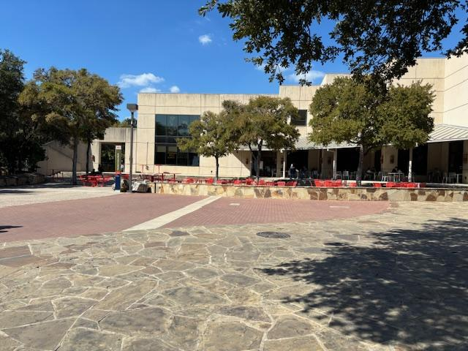
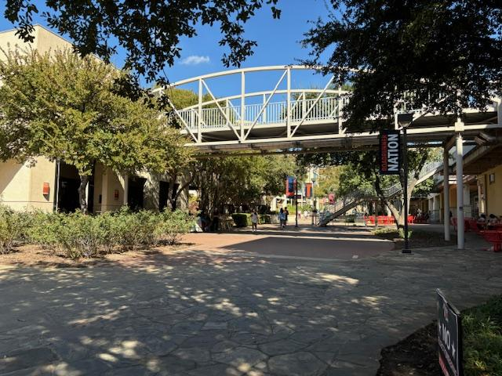
Form up Location Photos
Air Force ROTC Detachment 842 • We Build Exceptional Officers • The University of Texas at San Antonio

Slide 8
Questions?

Slide 9
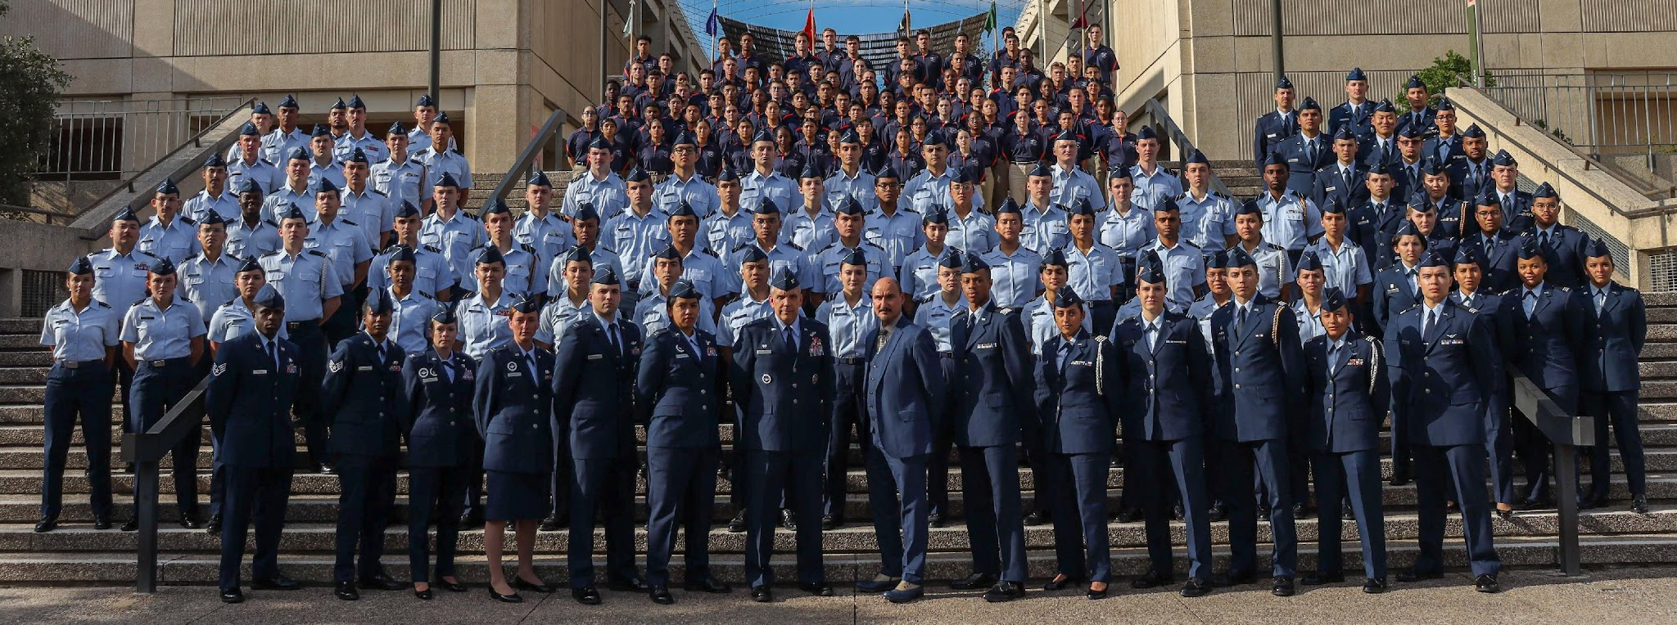
Air Force ROTC Detachment 842
The University of Texas at San Antonio
Det 842 – Best in Blue

